Slide 1

PARENT
TEACHER
ORGANIZATION
FALL MEETING
2023-2024
August 29 , 2023

Slide 2

BE in the know
PTO WEBSITE
  www.oakridgemiddlepto.com
EMAIL NEWSLETTER
  Go to Website to sign up
SOCIAL MEDIA
  FACEBOOK and INSTAGRAM
  @oakridgemiddlepto

Slide 3

PTO Website
https://www.oakridgemiddlepto.com
Purchase Spirit Wear – delivered in school
Support teachers – shop wishlists (will be updated by Wednesday)
Sign up for Volunteer Needs

Slide 4

Business Sponsors
https://www.oakridgemiddlepto.com
Banners are up for the full year and expire at the end of the school year
  Artwork must be vector
  Logo added to Newsletters and to Website for the year
Contact us to host a spirit night event
Silent Auction donations needed!

Slide 5
Mission statement
The purpose of the PTO is to encourage parents & teachers to WORK TOGETHER across various school activities/functions/services, to provide financial assistance where needs are identified within the school, foster a community atmosphere, and support the mission and vision of the school and school district.
Fundraise
Volunteer
Volunteers support programs such as Spirit Sales, Fundraisers, Lead Committees and Events and classroom help plus much more …….
93% of school budgets nationwide come from state and local taxes. PTOs and other fundraising mechanisms drive the rest of the school spending.

Slide 6
2023/2024 Operating plan
Classroom support
Increase Funding per classroom
Improve Classroom needs (volunteers, initiatives)
Define clear financial goals
Increase Fundraising
Define investment opportunities in school
More funds to student-based activity
Foster community & COMMUNICATIONS
Communication Increase
Spirit Drive!
Create fun!
VOLUNTEERS and TEACHERS
Increase Volunteers
Partner more with teachers and staff
Establish joint goals in community
1
2
3
4
$200 per classroom via Wishlist funding
Support grade level initiatives for learning
Address volunteer needs in classroom
Volunteerism and learning opportunity
Launch Fall Festival Fundraiser $25,000
Business Sponsorship Opportunities – stretch goal $5,000
Winter Fun A Thon fundraiser – goal $40,000
Create Schoolwide Funding needs list
Continue efforts with PTO website, Newsletter
Streamline Spirit Wear programs
Spirit Store Fridays
Continue Bash Events
Develop community programs
Support Afterschool Enrichment programs
Attract more volunteers school-wide
Work with teachers to understand their needs beyond fundraising by developing joint goals with Teachers via PTO Board platform

Slide 7
Calendar
DECEMBER
BASH – Dec 8th
Holiday Sales Event (7th – 8th)
JANUARY
BASH – Jan 26th
FEBRUARY
Souper Bowl Staff Appreciation
Valentine Sales Event (13-14th)
Valentine Dances - TBD
Spirit Store Event (11th,16th)
MARCH
Winter Fun A Thon – March 7th (TBD)
APRIL
BASH – April 12th
Community Event - TBD
5th Grade orientation - TBD
MAY
Staff Appreciation Week – TBD
End of year parties - TBD
8th grade dance - TBD
AUGUST
Teacher Welcome Back Lunch
Teacher Wishlist Shopping
PTO Back to School Parent Meeting (Sign up for PTO Volunteer Needs)
Spirit Store Event (2x month)
SEPTEMBER
BASH – Sep 22
PTO Volunteer Training – Sep 7th
Spirit Store Event (1st / 15th / 29th)
Curriculum Nights
OCTOBER
Fall Festival Fundraising Event – Oct 5th
BASH – Oct 20th
Spirit Store Event (13 / 27th)
NOVEMBER
Community Service Event
Spirit Store Event (10th)

Slide 8
FUNDRAISE
Fundraise
Board’s mission is to ensure all fundraisers support the mission of the PTO and can reach each child at OMS
Revenue Goal = $82K
5 Fundraisers/Events:
Fall Festival Event – October 5th
Spirit Sales Fridays – 2x month
Fun A Thon – March TBD
Bash Events – 5x per year
Silent Auction - November
School Store:
During Lunch – 2x month (Spirit Wear, Holiday events and Candy Sales)
Online Spirit Wear
Business Sponsorships
Banners & Monthly Ads
Spirit Nights
Silent Auction Event

Slide 9
BUDGET CHANGES THIS YEAR
Add additional funds for following
6th grade Requests
7th grade Requests
8th grade Requests
Q1, Q2, Q3 Celebrations – Academic Celebrations
Maintain Revenue:
Fall Fundraiser – increase to $25K
Bash - $5,000
Holiday Houses - $5,000
Spirit Store - $10,000
Business Sponsorship Ads - $2,000
Wishlist For Teachers – Back to School
For every classroom teacher, $100 in Aug/Jan
For every non-classroom staff $50 in Aug/Jan
Wishlist Shopping Plan
PTO Website has link for every teacher
PTO will shop and promote to parents
Parents can find classrooms and shop for teachers
Teachers to add their wishlist in communications to parents
Goals for School – Alignment with Families
PTO to promote the goals and create consistent messaging

Slide 10
Budget

Slide 11
OMS PTO BOARD -
Volunteer
The Board Should be representative of each student and faculty
Teacher Representatives and Ensure Board Members represent each grade level.
Extend Volunteer and Leadership to more parents
Create a more structured PTO Environment
Continue Monthly Meetings (Web-ex or in Person) at a time that works for all
Add more parents and teachers/staff to the board meetings
Facilitate 2 Fall and 1 Spring Parent Coffees in person and on-line
Communication:
Grow Email Subscription for PTO
Monthly communications that are consistent (1st Thursday of the month)
Send home PTO Newsletters for big Events
Continue Website (share with students)
Additional ideas to explore
Spirit Spy Program
Kindness Initiative expand beyond Giving Tree
Banners inside school PTO can fund
Celebrations that promote and foster positive experiences funded by PTO
More awards provided to students (prizes funded by PTO)
Enrichment opportunities that Parents can volunteer and PTO can fund (beyond CCPS programs)

Slide 12
PTO ROLES
PTO Board (Voting Rights)
PTO Organization (Non-Voting Rights)
School Spirit Lead
Business Sponsor Lead
Holiday House Lead
Kindness Initiative Lead
6th GLR
7th GLR
8th GLR
President
Treasurer
Secretary
VP 1
VP 2
Teacher 8th
Teacher 7th
Teacher 6th
Principal

Slide 13
VOLUNTEER
To Volunteer for School and PTO
Visit Website: https://www.collierschools.com/volunteer
Review materials provided by school administration (Volunteer Training Meeting and Video)
Send email to OMS to confirm steps 1 & 2 (see website)
Search for PTO Volunteer Needs
Visit Website: Sign Up Genius
Search for opportunities using email: oakridgemiddlepto@gmail.com
Be in the know – email, social media and website

Slide 14
Volunteer VIDEO
https://media.collierschools.com/media/Volunteer+Orientation./0_mv37upq6

Slide 15

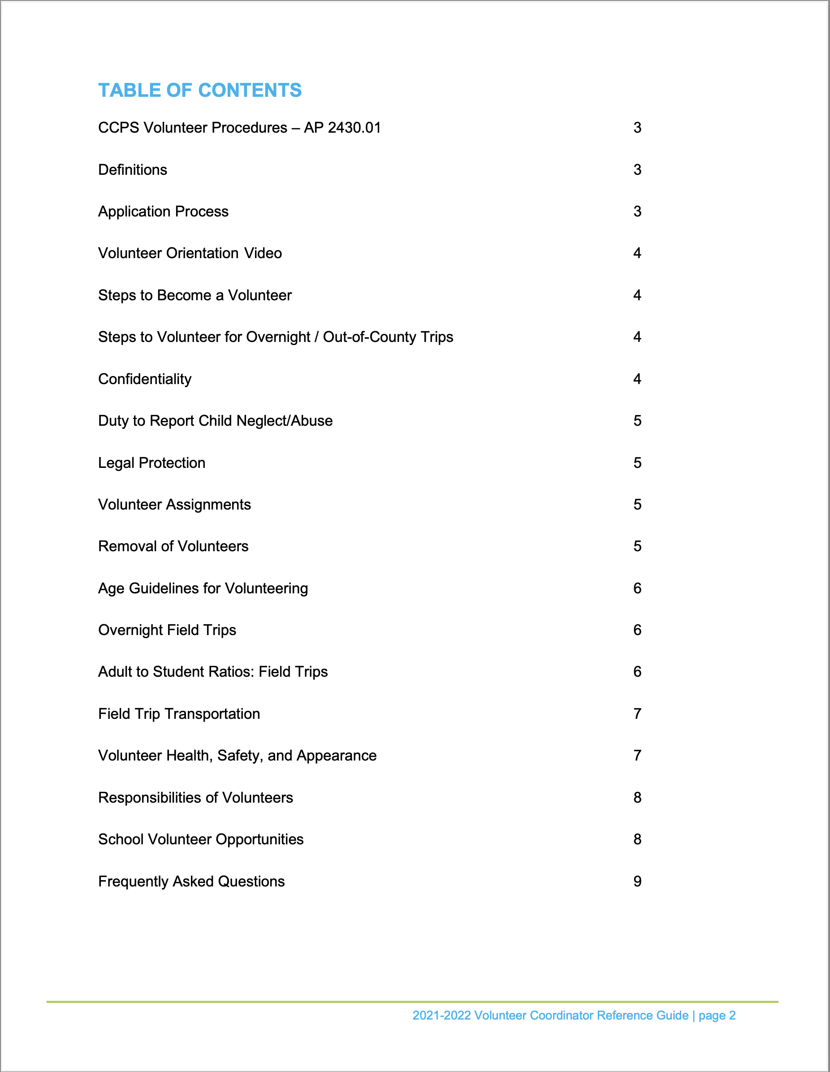

Slide 16
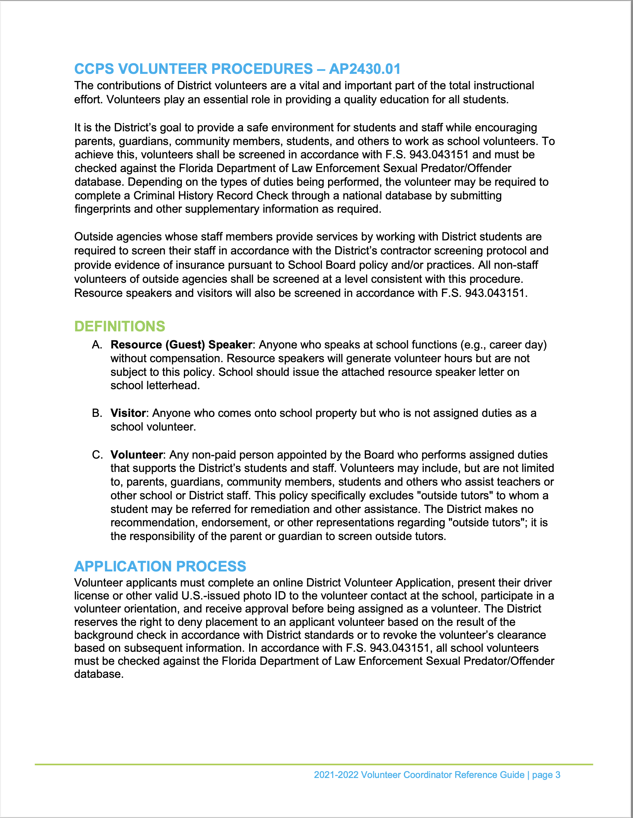
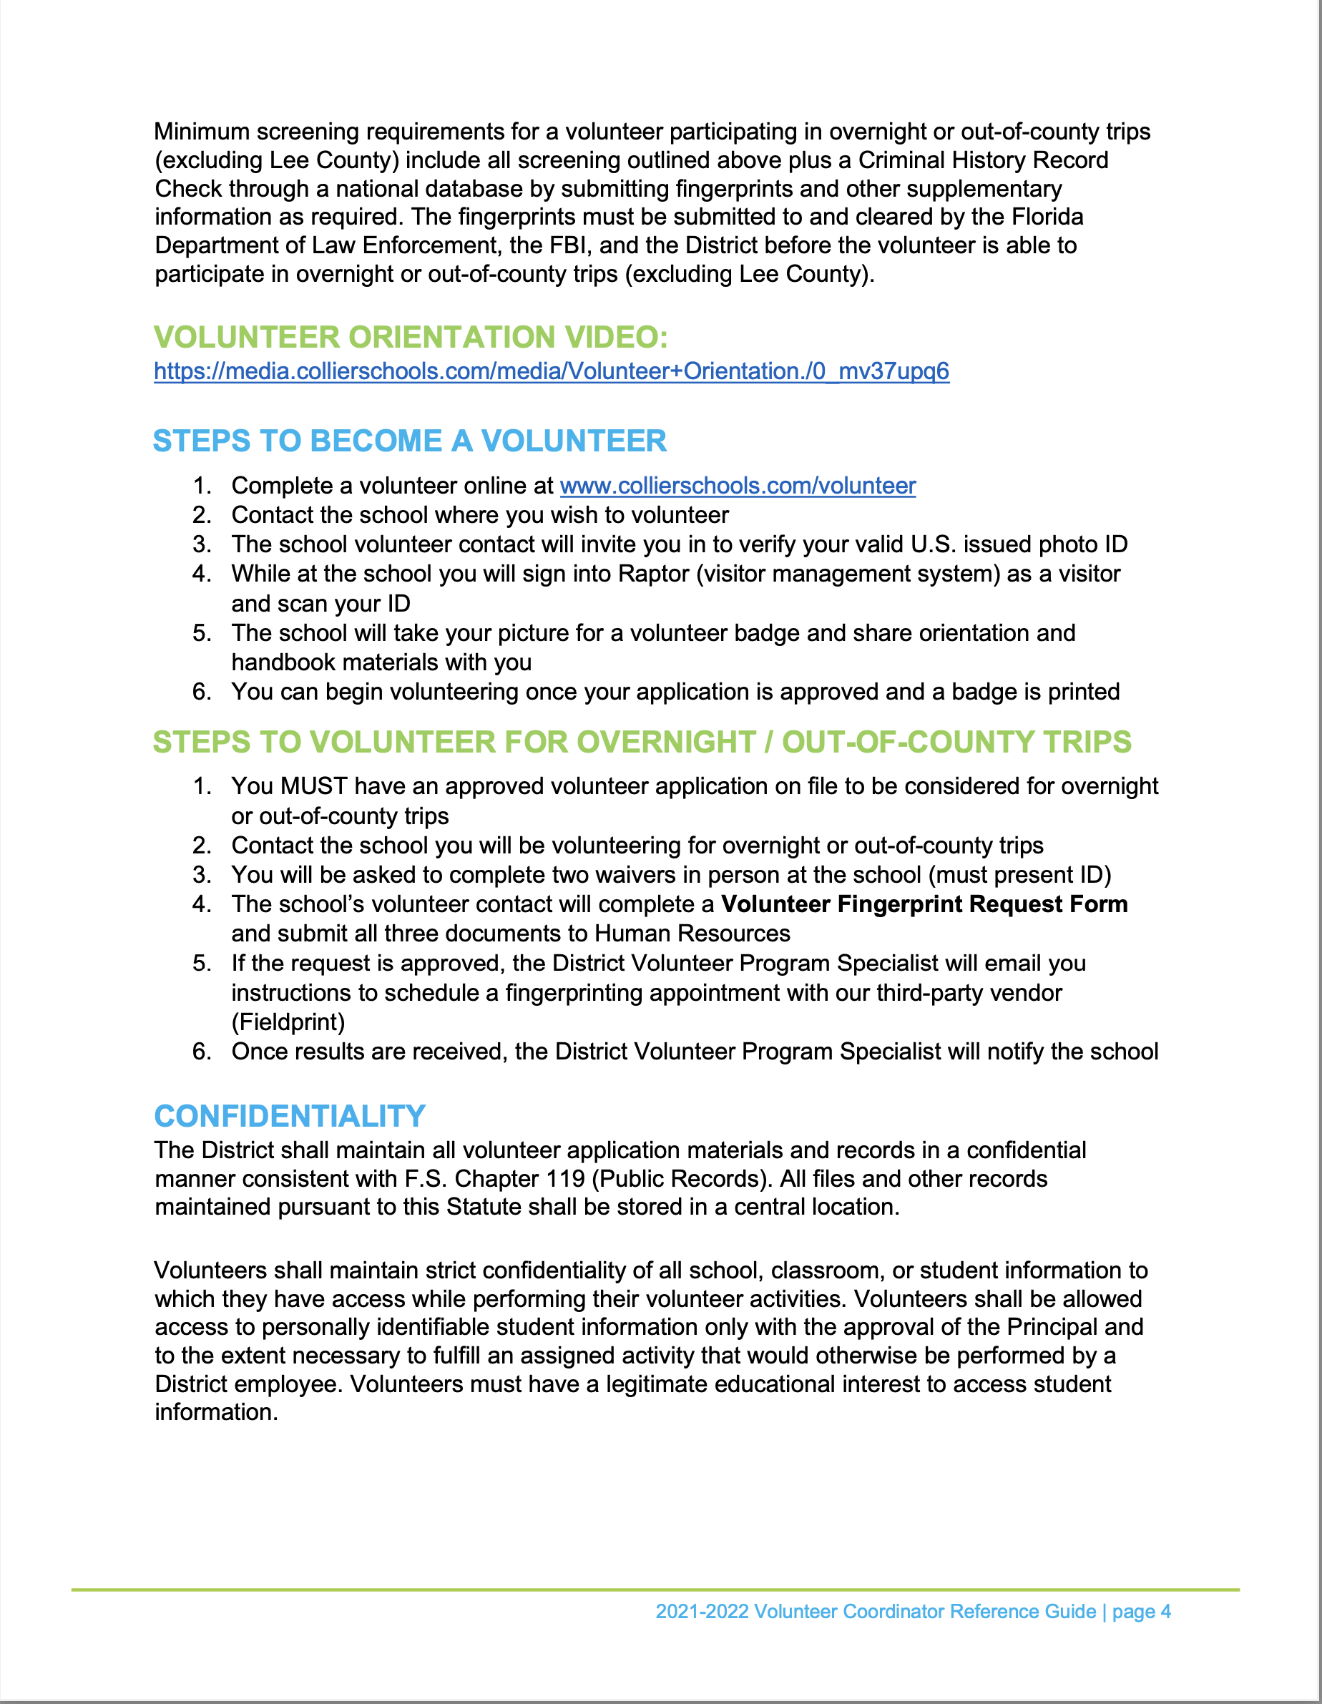

Slide 18
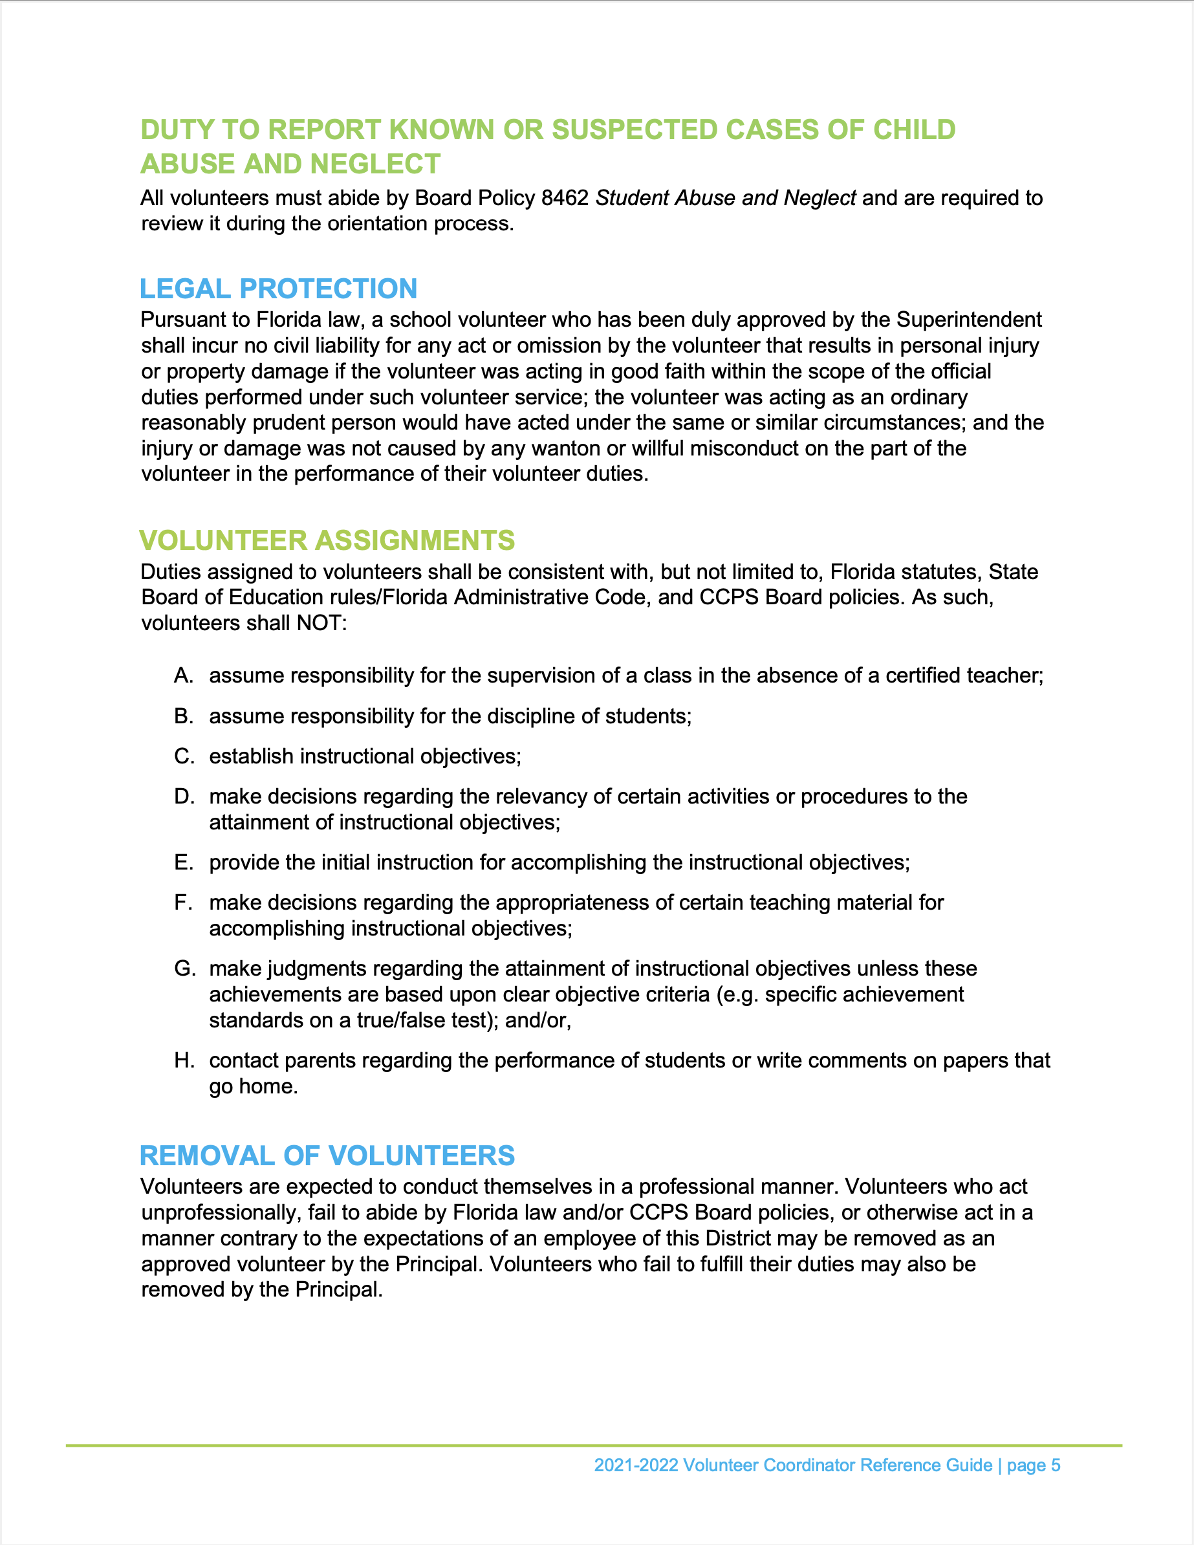
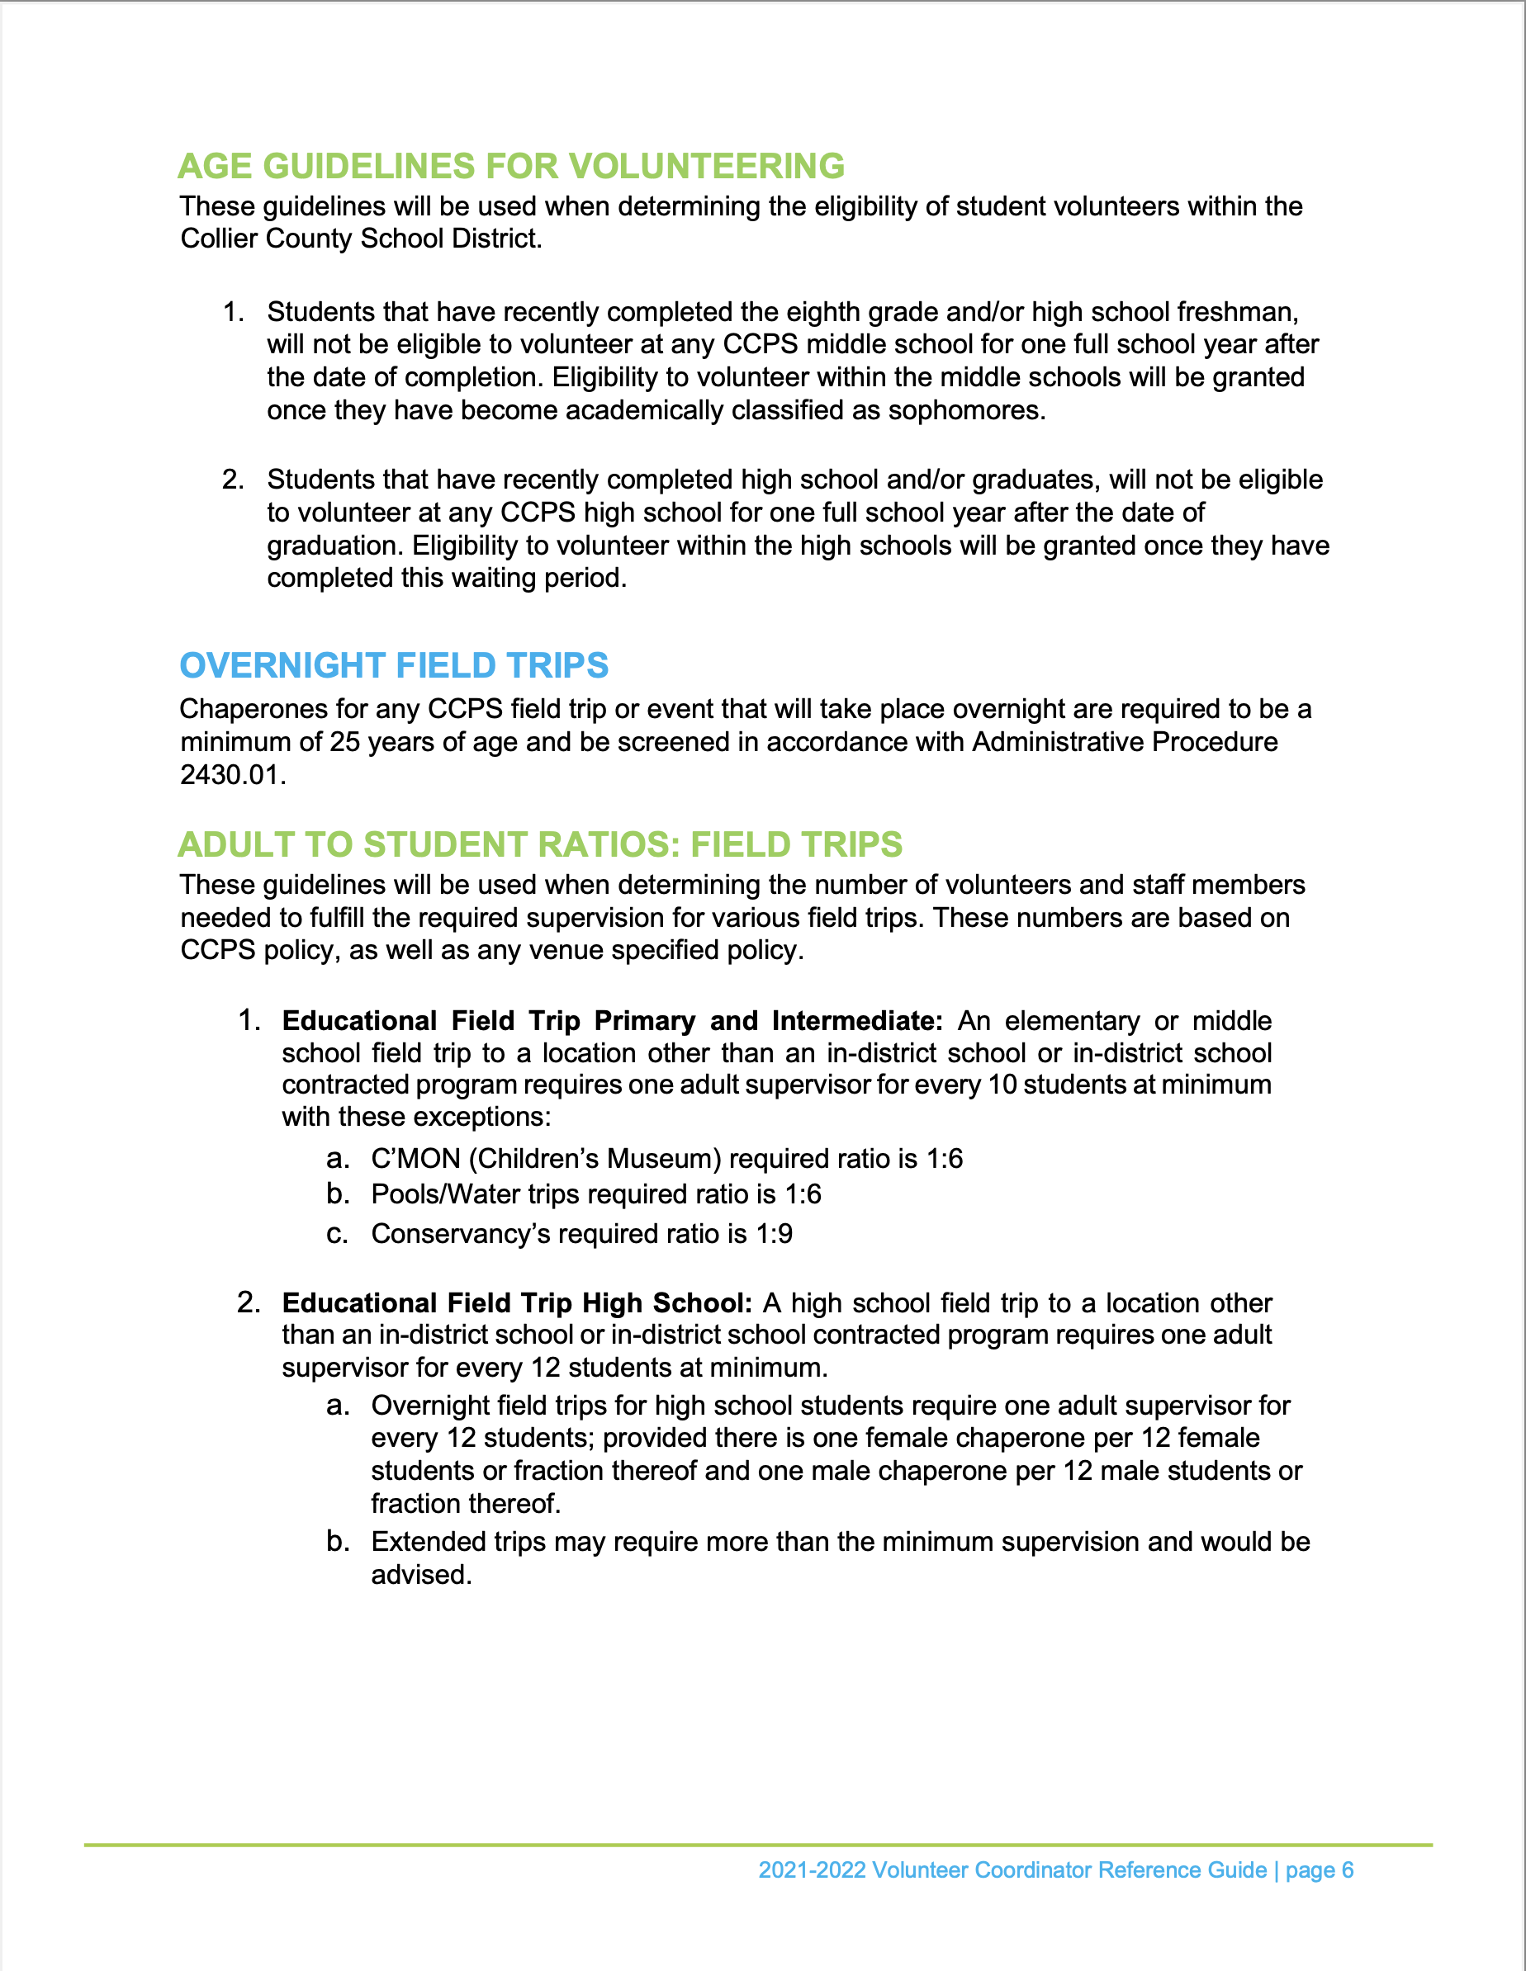

Slide 19
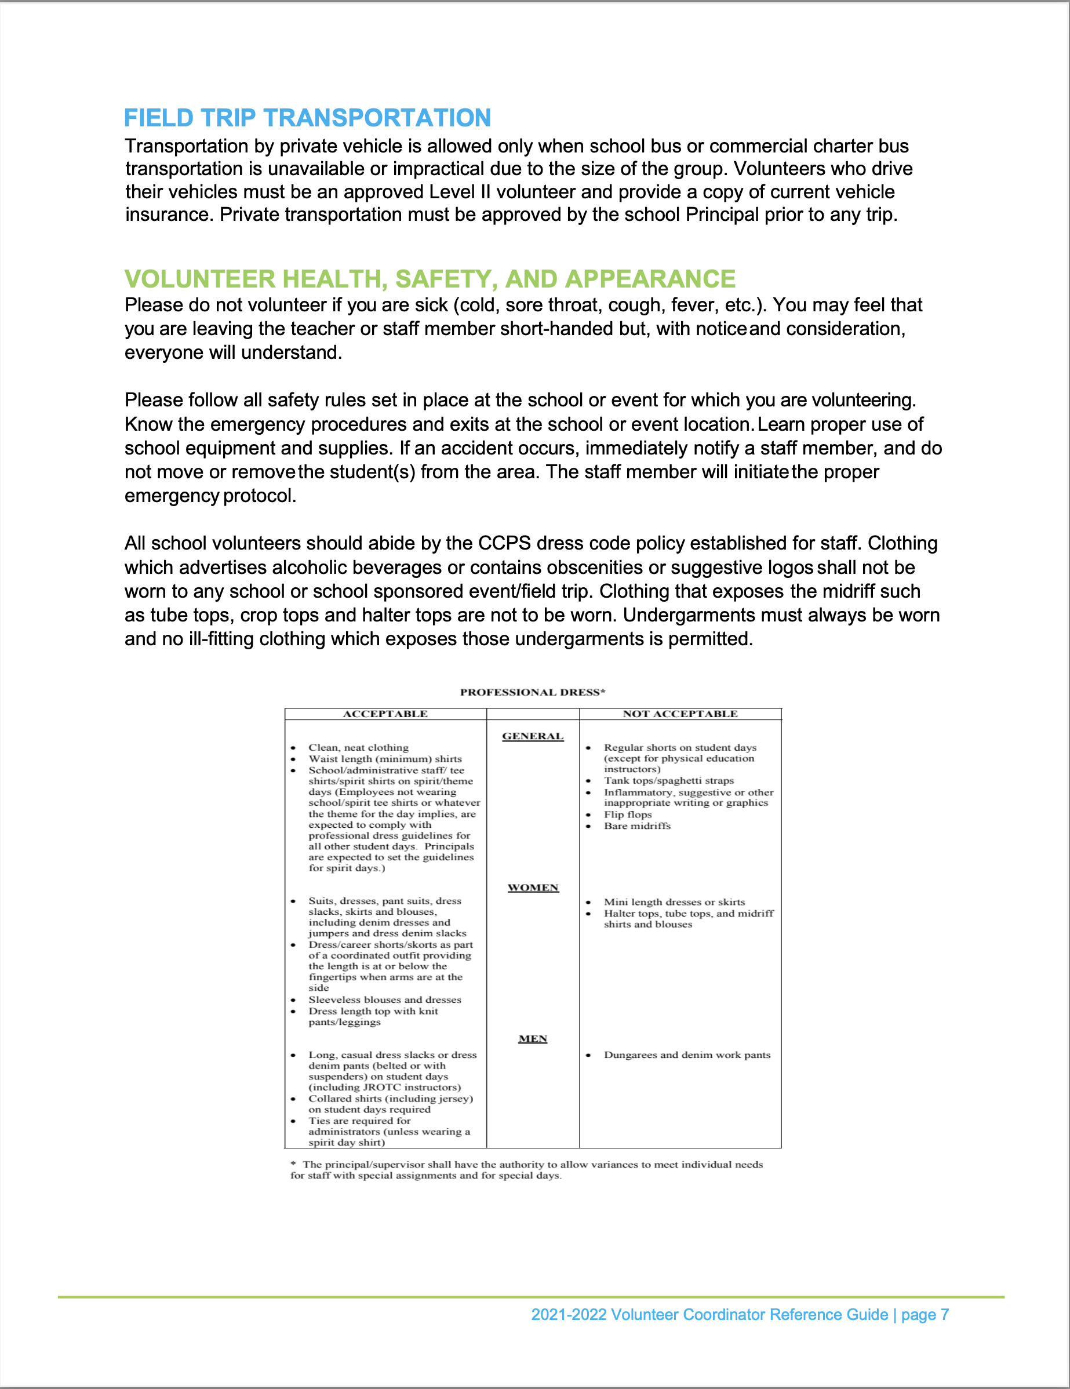
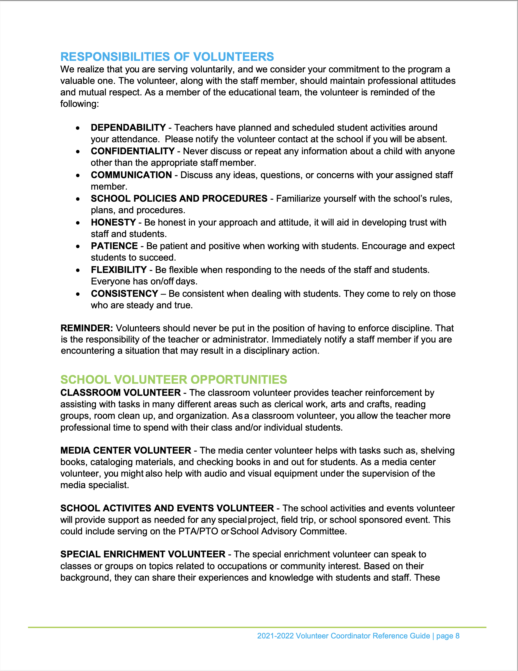

Slide 20
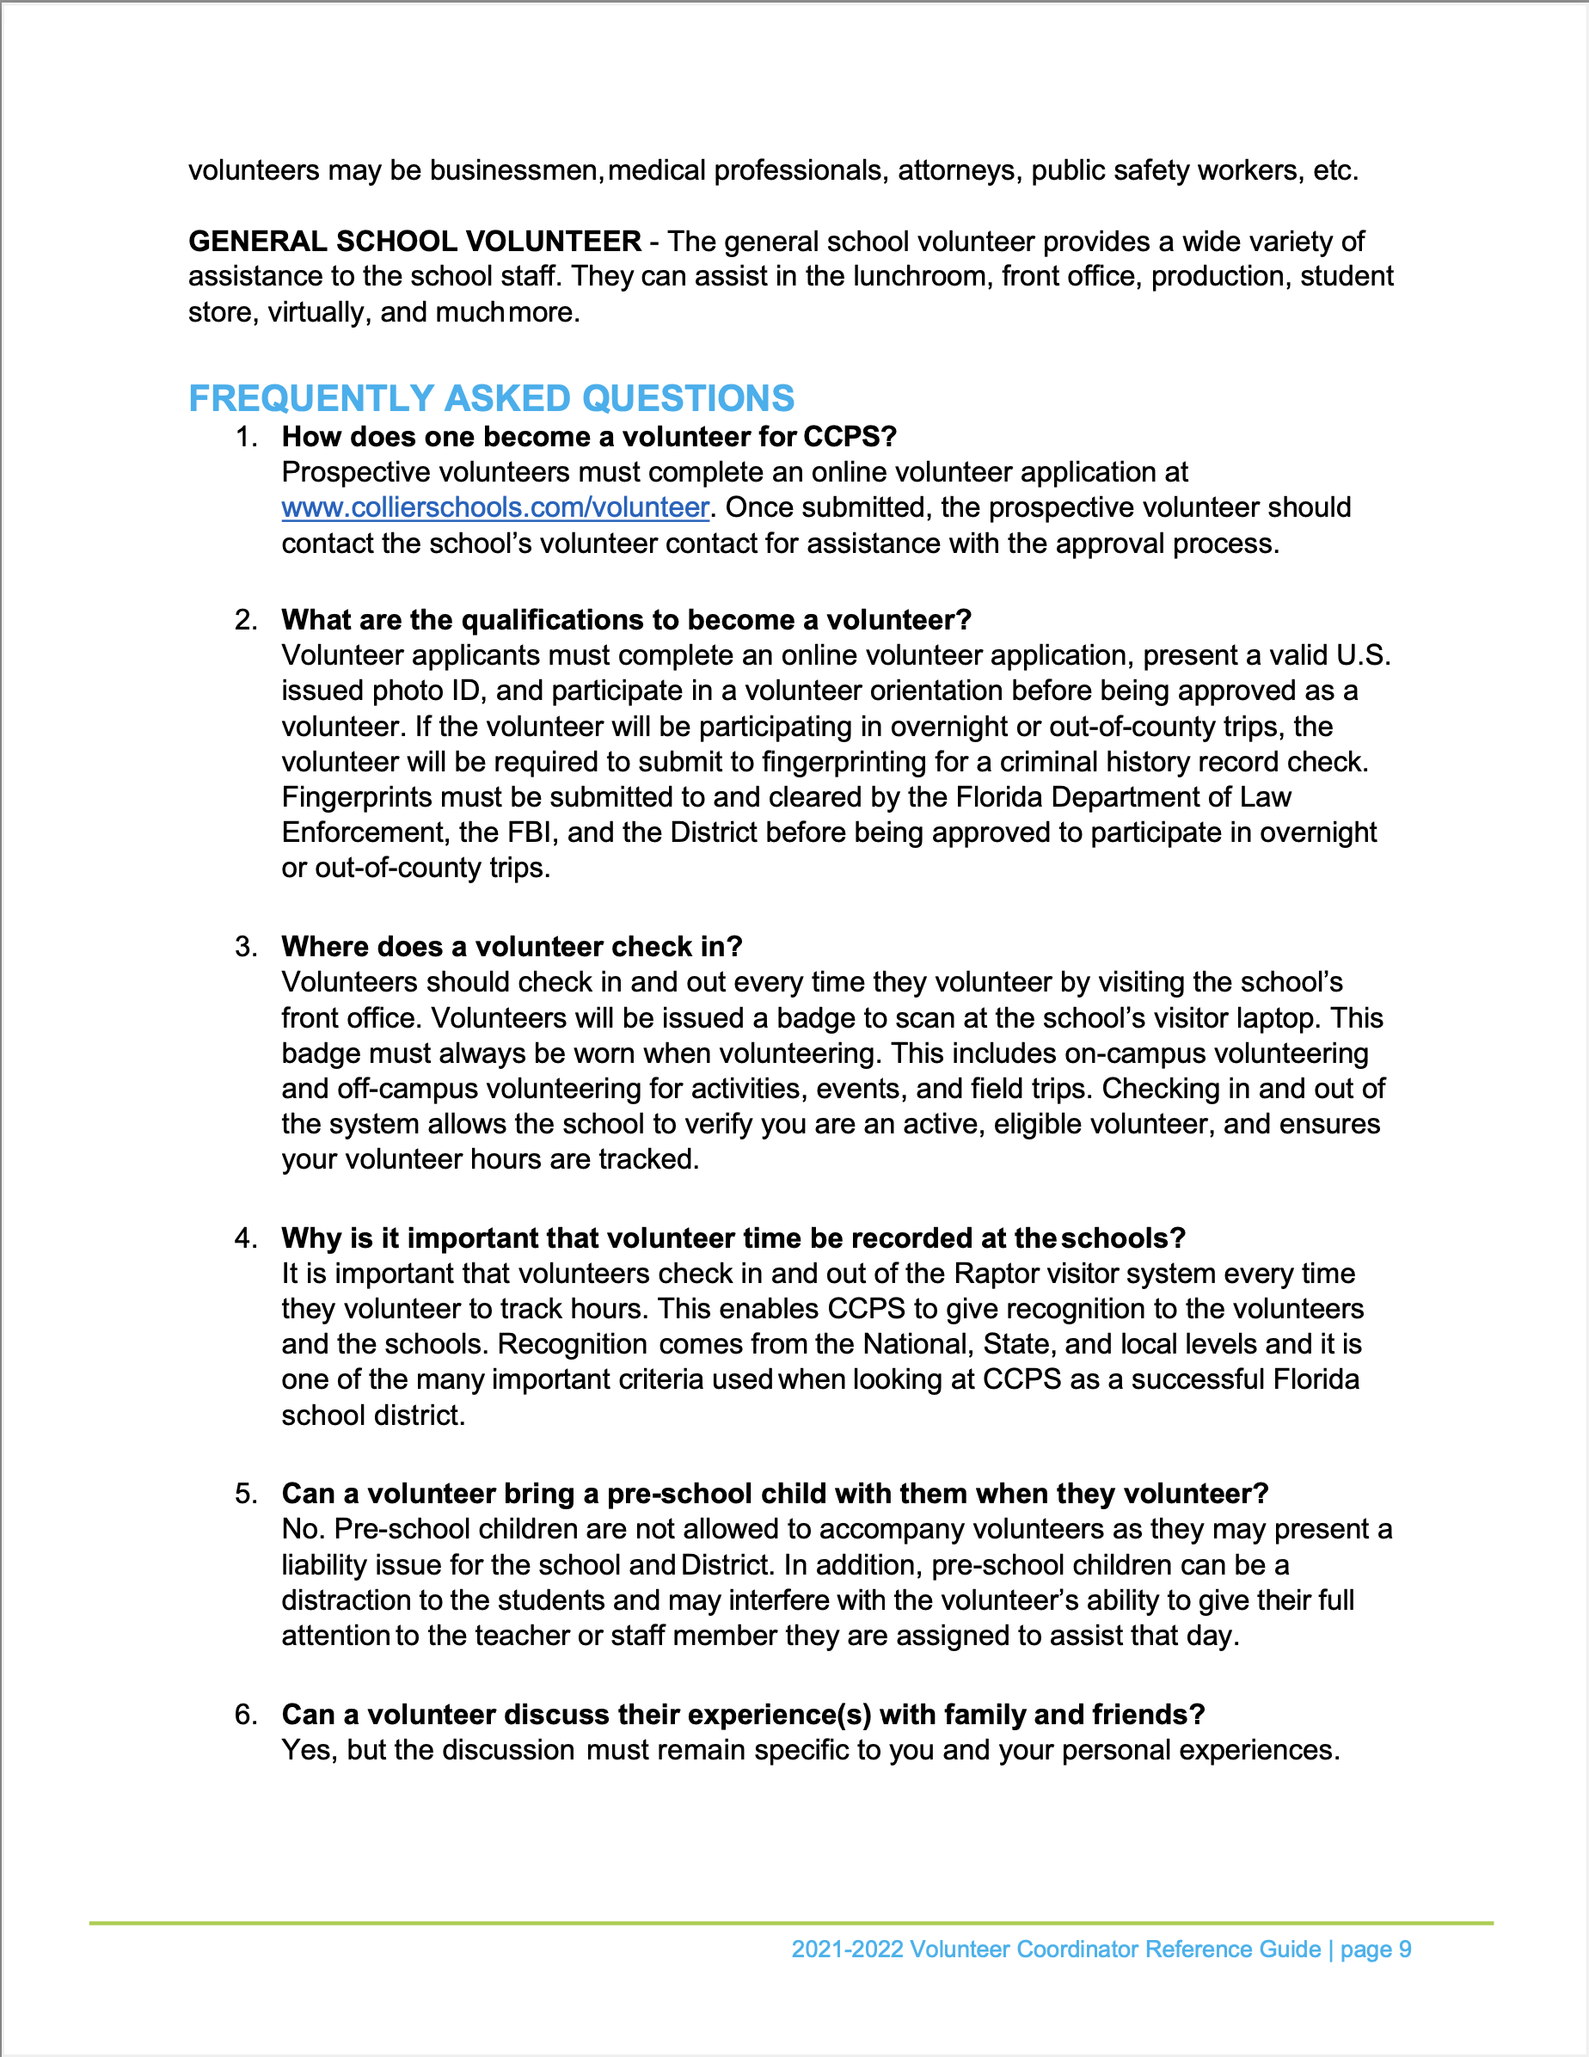
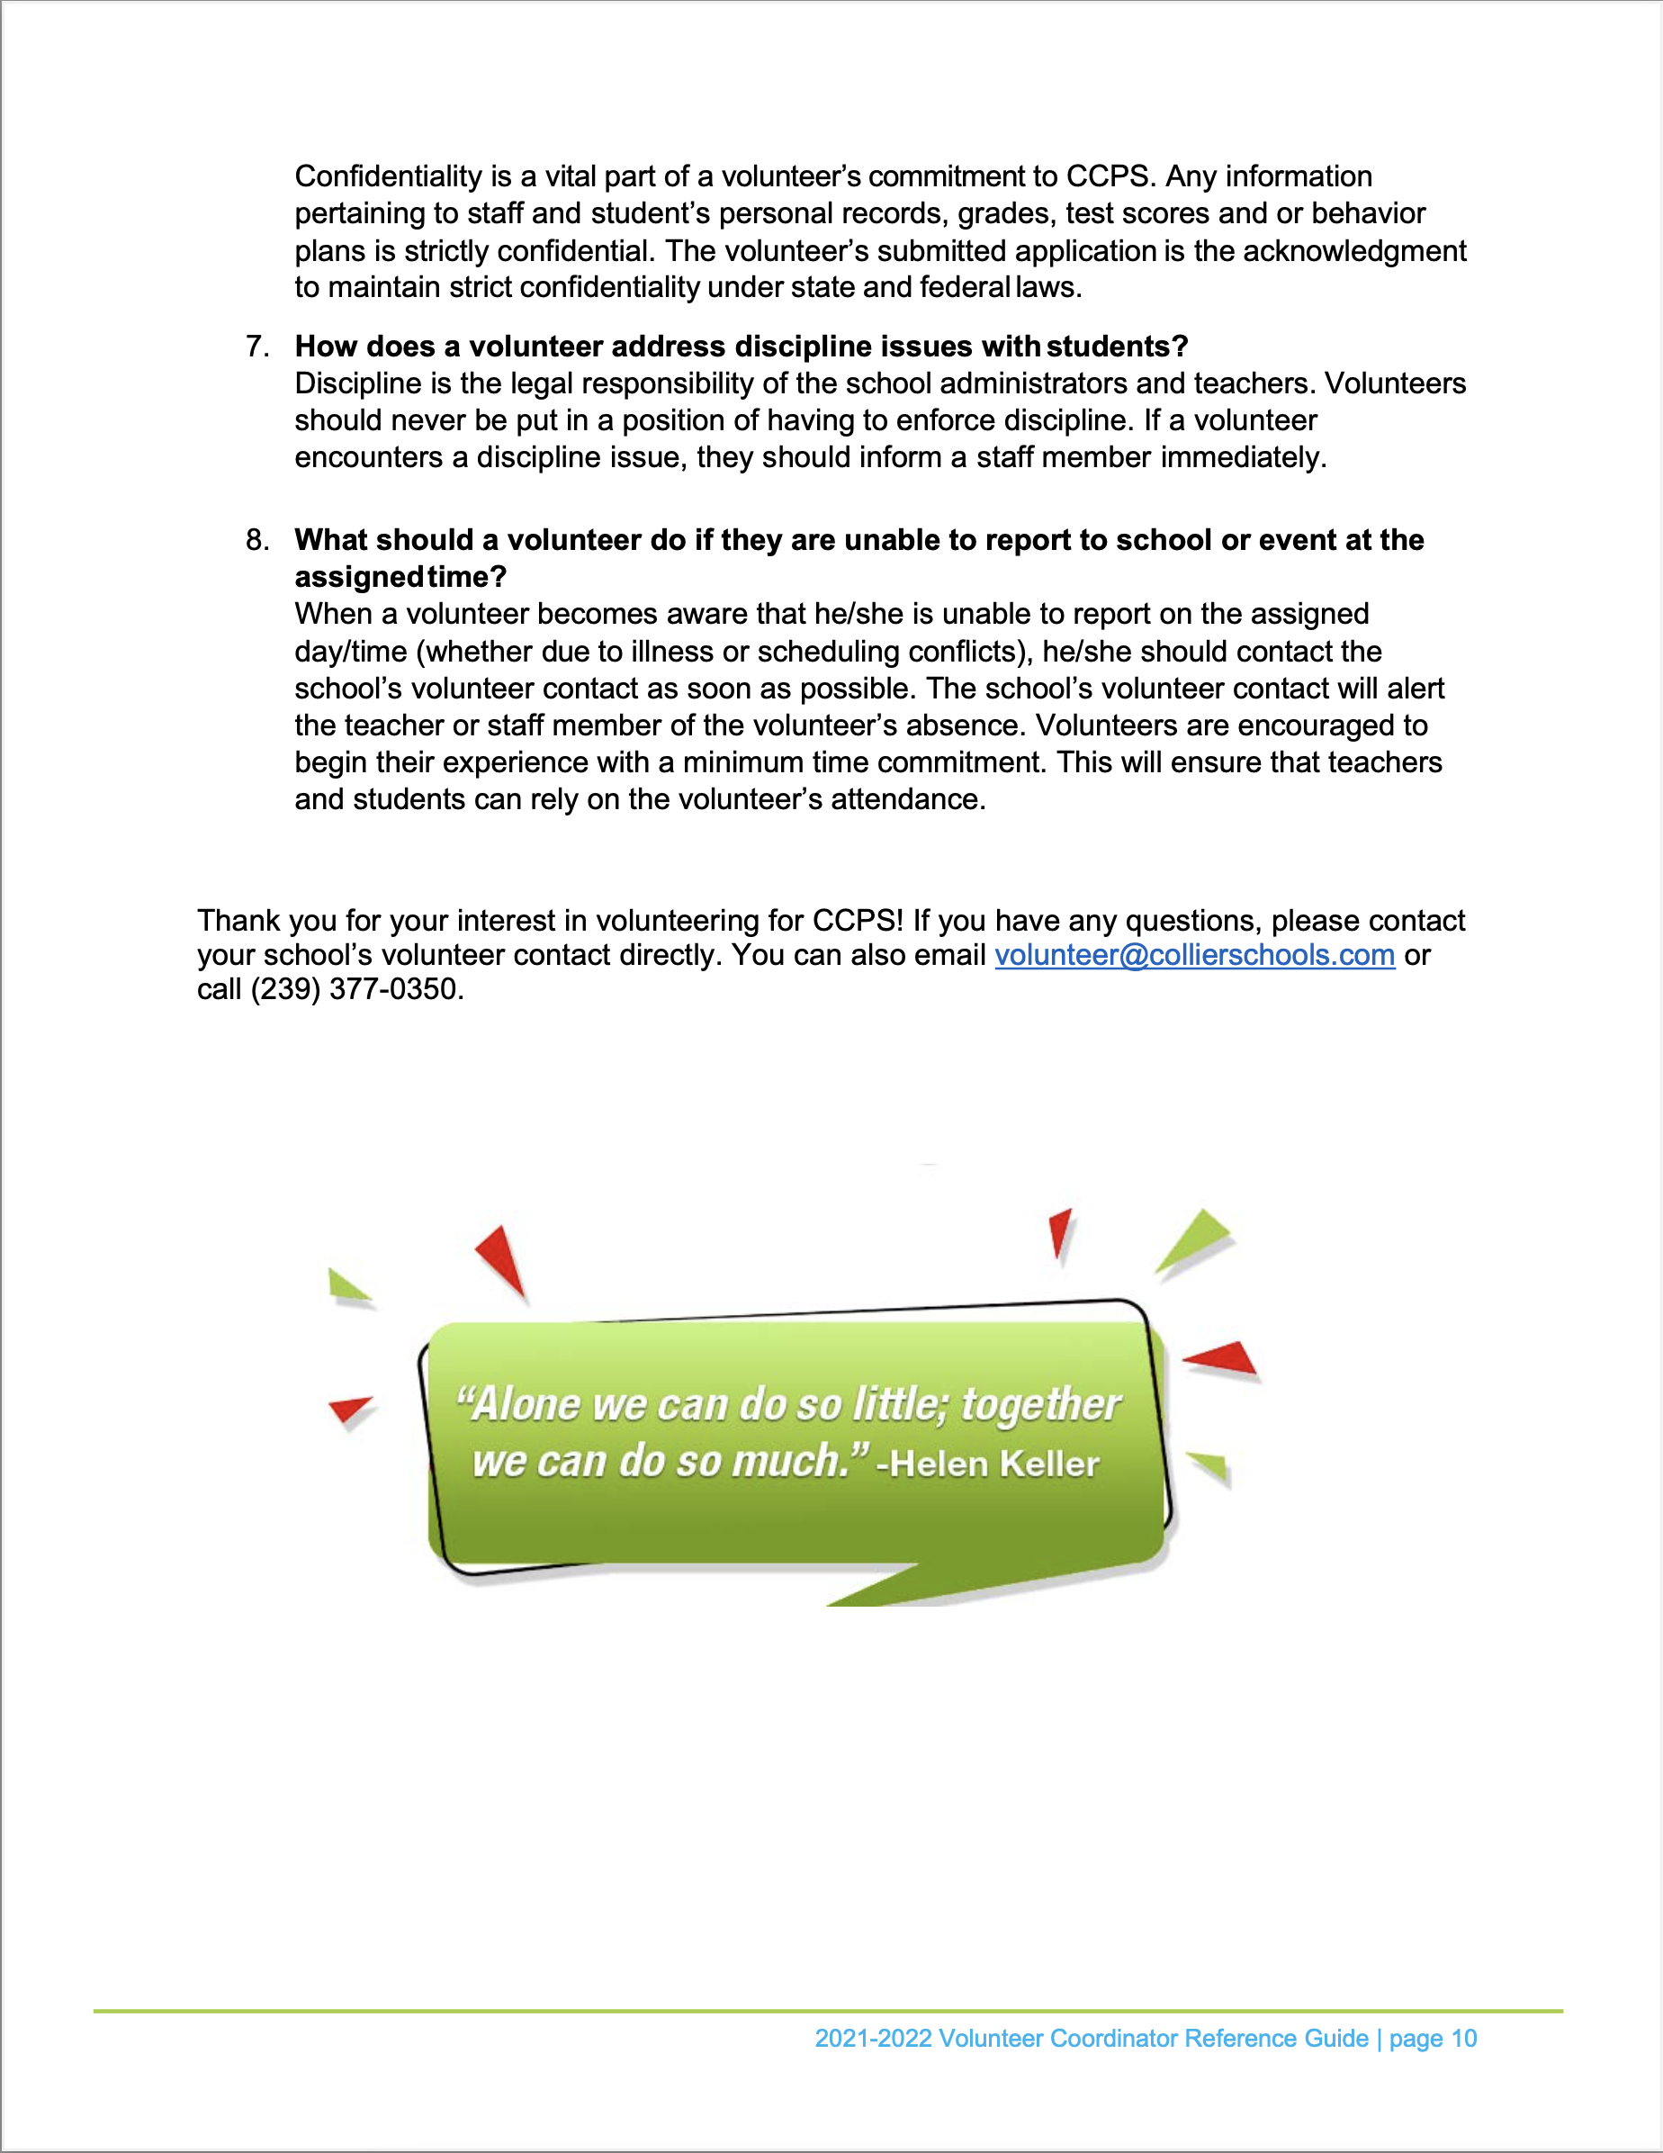

Slide 21
School Safety
Pick up-Afternoon car line:
Goal: To have a safe and efficient process for pick up. Another goal is to have vehicles/ buses get off 951 and get on campus as quick as possible. Vehicles and buses can’t get on campus because traffic is backed up to the red light on 951. The bullet points below will help this process.
If possible, car pool with family or neighbors to minimize the number of cars in the line.
Pick up your students all the way forward in the line by the flag pole, not farther back, with gaps in the car line (and more cars backed up onto 951 because of this).
If possible, please have some parents arrive on campus at 4:00-4:05pm to pick up their student(s). The line slows down at this time. This will minimize the amount of cars on campus during the peak times and keep more cars off 951 and get more school buses on campus quicker.
Bicycles:
Please have the students wear their helmets if they are riding their bikes to and from school (per FSS 316.2065 (3)(d).
Please have the students that take Collier Blvd (951) to and from the school to be careful with vehicles at intersections. Don’t assume the driver sees you.
Please park their bikes in the bike racks (by the gym and Pebblebrooke). This will help with reducing the chances of theft.
Please lock your bikes to something solid (thru the frame and front tire).
Learn Safe/ Computers:
Please remind your students to be careful what they type/ search on their CCPS laptops.
A resource for Learn Safe is: https://learnsafe.com/
Have your students lock their school issued laptop by using the Windows button and the L key. This prevents unauthorized people access to the laptop and reduces Learn Safe activations.
Social Media/ Texts etc.:
Please remind your students about their social media posts, social media groups that they are in and their security settings etc. on their accounts.
Please remind your students about texts, group texts and sending photos/videos etc. When in doubt don’t send it/ don’t forward it. If something is sent to them that is inappropriate, have them notify a parent.
A resource for Social Media Safety is:https://www.collierschools.com/Page/10216

Slide 22
School Safety
Vapes:
Please be familiar with what nicotine and THC (marijuana) vapes look like. They are illegal to possess for juveniles; especially on school property/ buses.
Possession of a nicotine vape on school property/ bus is a citation from me and school consequences with the AP-D’s office.
Possession of a THC vape on school property/ bus is going to be a civil citation issue from me and school consequences/ alternative placement from the AP-D’s office.
Fights/ Battery:
Please remind your students to keep their hands to themselves to avoid a possible civil citation from my office and/ or school consequences from the AP-D’s office.
Vandalism:
Please remind your students to not damage school property (especially bathrooms) or other students belongings. This will help them avoid a possible civil citation from my office and/ or school consequences from the AP-D’s office.
Threats:
Please remind your students to be careful what they say in person or send on social media/ texts/ phones etc. A good practice is “think before you say something or send/post something. When in doubt, don’t say it or don’t send it/ post it.”
A resource for reporting threats is:https://www.collierschools.com/Page/11590

