Slide 1
PARENT
TEACHER
ORGANIZATION
WELCOME BACK TO SCHOOL
2021 – 2022
AUGUST 26, 2021

Slide 2
AGENDA
Introduction to LOE PTO
Board and Roles of PTO – What do we do?
2021-2022 Operating Plan
Financial Plans and Fundraiser Overview
Clubs & Activities: Golf
Clubs & Activities: Odyssey of the Mind
Clubs & Activities: Yearbook Club and Lego Robotics
Volunteering and Leadership Needs
Support the Classroom – Wishlist Shopping / Amazon Smile / Box Tops
Business Sponsorship
Upcoming Events: Fall Festival, Silent Auction and Art Show Events
Fall Activities: Picture Day, Book Fair and Holiday House
Be Involved!

Slide 3
Mission statement
The purpose of the PTO is to encourage parents & teachers to assist with various school activities/functions/services, provide financial assistance where needs are identified within the school, foster a community atmosphere, and support the mission and vision of the school and school district.
Fundraise
Volunteer
93% of school budgets nationwide come from state and local taxes. PTOs and other fundraising mechanisms drive the rest of the school spending.
Volunteers support programs such as Enrichment, Fundraisers, Book Fairs, Picture Days, Lead Committees and classroom help plus much more …….

Slide 4
LOE PTO BOARD
https://www.laureloakpto.com/ptoboard
Fundraise
Volunteer
Delivered $120K in Funds to LOE last school year before expenses
Drive funding via Fundraisers, sale of yearbooks, spirit wear, holiday house and classroom funding
Board’s mission is to ensure all fundraisers support the mission of the PTO and can reach each child at LOE
The PTO Board is comprised of 5 parents, 3 teachers and the principal. Each member of the board has voting rights. Term Limits are 2 years (except for Teachers and President (3 years))
Grade Level Reps are parents that support PTO functions at a grade level and they attend PTO Board meetings. They do not have voting rights.

Slide 5
PTO ROLES
PTO Board (Voting Rights)
PTO Organization (Non-Voting Rights)
GLR K
GLR 1
GLR 2
GLR 3
GLR 4
GLR 5
Enrichment Leads
Business Sponsor Lead
Book Fair Leads
Holiday House Leads
Kindness Leads
Photos / Yearbook Leads
Art Show Leads
President
Treasurer
Secretary
VP 1: School Spirit Sales, Spy
VP 2: Hospitality
Teacher K-1
Teacher 2-3
Teacher 4-5
Principal
VP 3: General

Slide 6
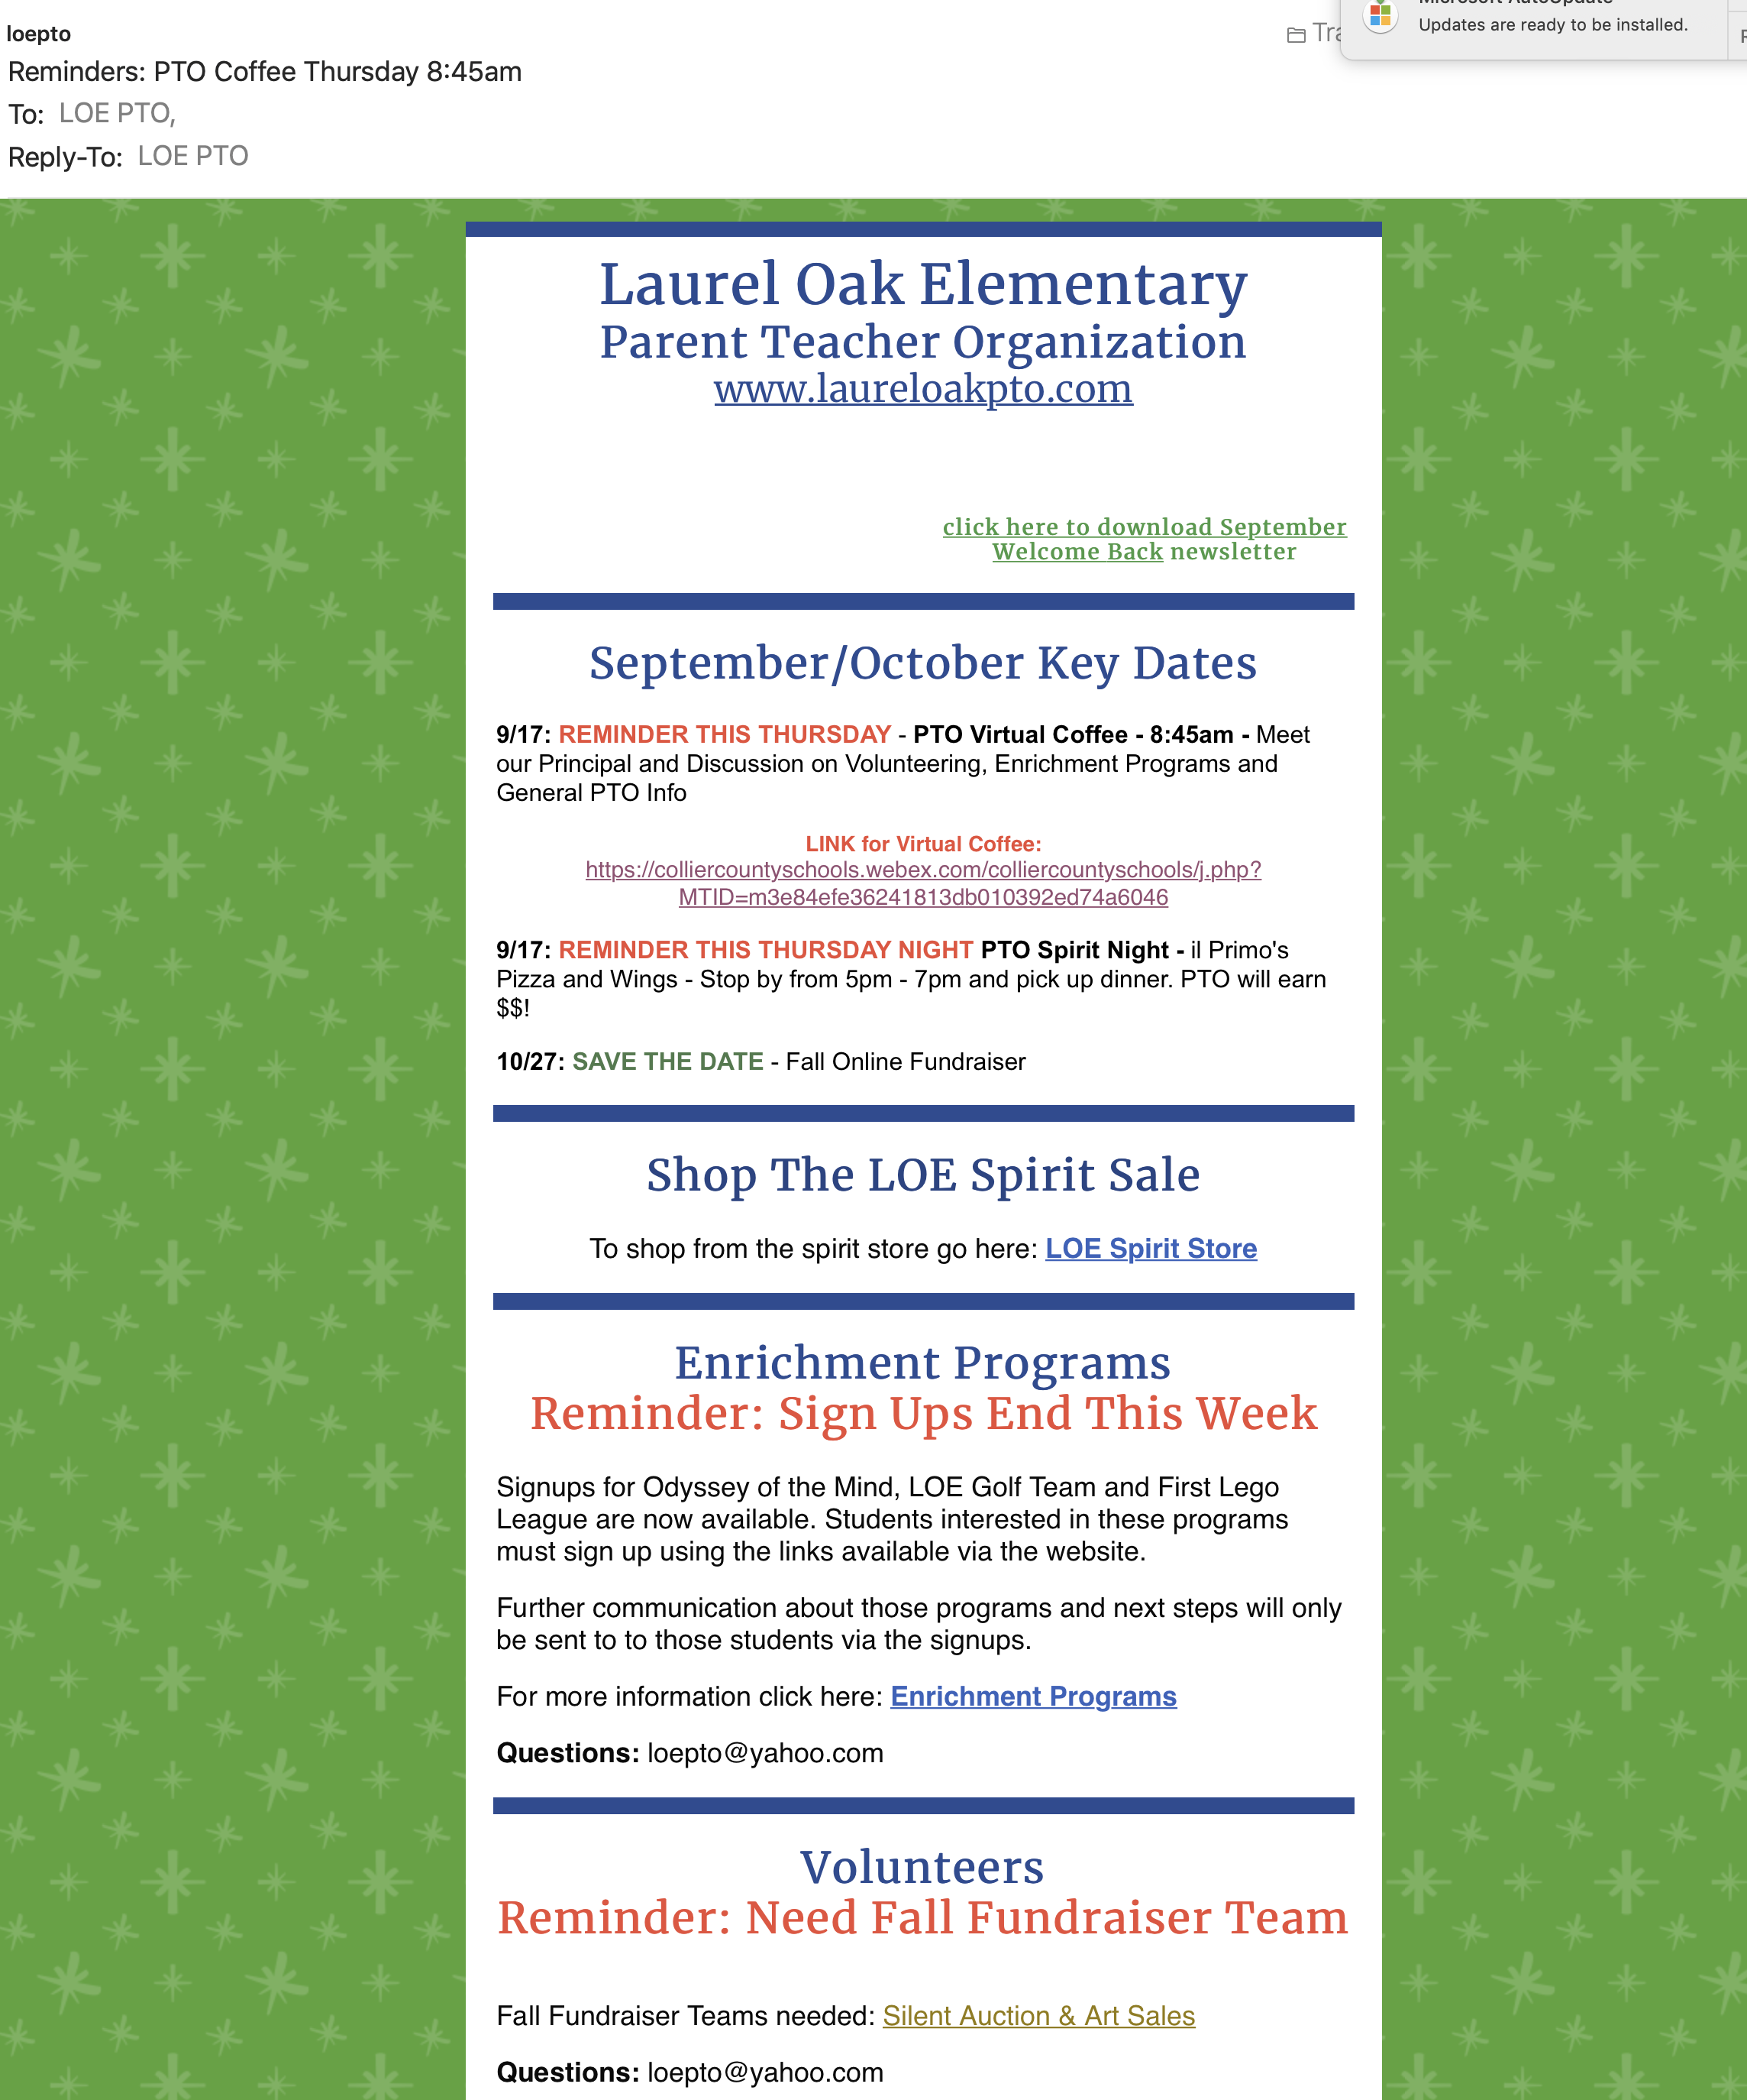
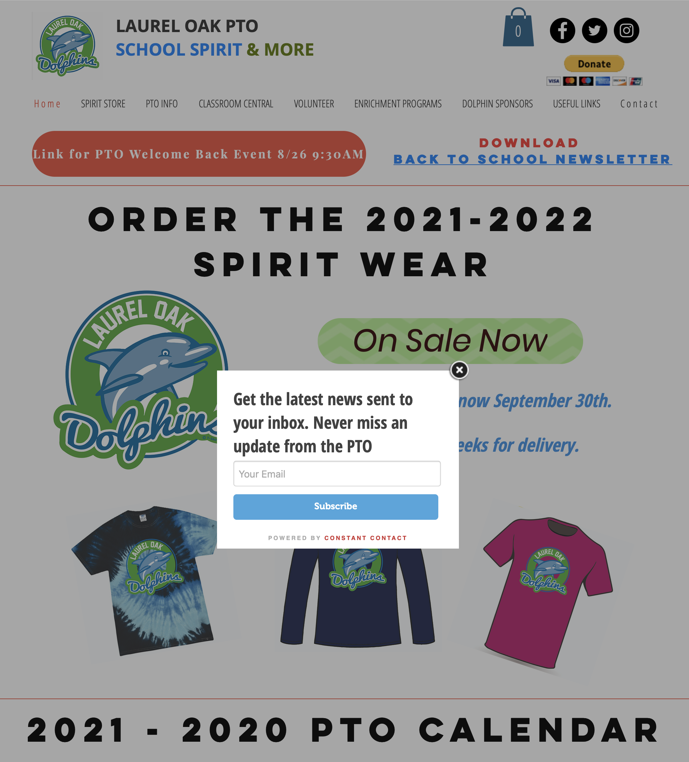
Be in the know
Newsletters go home each month for classroom students (in blue folder) → good to hang up at home
Newsletters go home each month via Email Newsletters and are Posted on PTO website
Emails are used to communicate most frequently
PTO Website is always up to date!
Teachers also receive all PTO communications
Laurel Oak PTO in a non-for-profit organization: no membership dues to be part of this community!
https://www.laureloakpto.com

Slide 7
2021/2022 Operating plan
Classroom support
Increase Funding per classroom
Improve Classroom needs (volunteers, initiatives)
GLR More Involvement
Define clear financial goals
Maintain Spending
Maintain fundraising
Grow Business Sponsorships
Foster community & COMMUNICATIONS
Create moments to connect in our community
Communicate acts of kindness
KEEP GOING
1
2
3
4
Amazon Wishlist – continue investment and communicate
Room Parent Coordination - continue program and increase visibility with Fall / Spring touch-base meetings with teachers and room parents
Maintain – ensure programs are adequately funded. No surprises
Classroom Money – drive more funding towards classrooms and students directly
Dolphin Sponsor – grow the program by selling banners. Ad funds go to Music department. Banner funds go to Enrichment.
Kindness Committee – Hold a Fall and Spring Event
Parent Networking Events – In Person 2x a year
Create Kindness events for school by volunteering in our Naples community
Continue to work on existing programs while navigating challenging school environment.
Enrichment – search for new ways to create new learning opportunities for students with the help from teachers and parents.
Transition - Grow leadership within PTO Network, focusing on more parents taking on leadership positions.

Slide 8
GOALS for this year
Classroom Funding – continue to support the needs of teachers and classrooms via Wishlist and Events
Roll out Grade level parties for Winter and Year End where GLRs work with teachers to organize events. PTO sponsored
GLRs to expand their visibility and support of each grade as needed
Bring back Fall Festival * and onsite Holiday House *
Create Yearbook Club
Look for Enrichment opportunities that PTO can sponsor moving forward
Continue improvements across all areas but keep doing what works well
Successful board transition project work
* Evaluate activities throughout the year per environment

Slide 9
Full YEAR FINANCIALS

Slide 10
EXPENSE – 2021-2022 BUDGET

Slide 11
NET revenue 2021-2022 BUDGET
Net Income: $75K

Slide 12
Enrichment programs
https://www.laureloakpto.com/enrichment
Students must sign up via PTO Website. Emails will then be sent out to prospect students.
By signing up, you will receive next steps and updates for that program. It does not mean that your child is assigned to that program.
EXPECTATION: Students who participate in any of these programs are expected to be on their best behavior and come prepared for all meetings / sessions / events
Parents who are not leading these activities are expected to be fully engaged and support their child’s program. This is not a drop-off activity
All of the programs include a competitive aspect but winning is not the main focus of the experience .. Although it does feel nice.

Slide 13

GOLF TEAM
Tryouts:
Students must be signed up to attend the tryout – contact: ddtbrownlee@gmail.com
will be held at Arrowhead Golf Course
starting times will be scheduled between 4:30 and 5:30 and your exact time will be provided on Thursday, August 26th
will play 4-5 holes
children need to wear collared shirts
Please print and sign the attached Parent Waiver and bring with you to tryouts.
Student requirements:
-must be able to play 4-5 holes with little instructional assistance
-must be able to carry their own golf bag (or use their own pull cart)
-must have a basic knowledge of golf rules, etiquette and display great sportsmanship
-for 4 holes, they should be scoring around a Par 16 -→ 18 - 30
Yardages for tryouts and matches will be:
Par 3 = 80 - 100 yards
Par 4 = approximately 150 yards
Par 5 = approximately 175 yards
Double par plus one is the most a player can score on any hole. For example, on a Par 3 hole, the player can take a maximum of 6 strokes. If they haven't completed the hole by their 6th shot, they get a 7 and must pick up their ball.
For those students who are beginning or new to golf, we encourage you to register for other First Tee golf programs. Information can be found at https://firstteenaplescollier.org/
If your child makes the team:
-you will need to register your child with First Tee and pay a $90 registration fee
-matches begin week of October 11th and run through the 1st week of November (possibly later with typical rescheduled rainouts)
-matches are held on weekdays only, and the day varies through the season
-Championship Tournament will be held either November 20th or 21st
-matches start at 4:30 and are played on various courses in Collier County. Parents are responsible for transportation.

Slide 14
ODYSSEY OF THE MIND

Slide 15
OTHER PTO SPONSORED ACTIVITIES
First Lego League
Yearbook Club
Sign Ups:
Open to 5th Grade Students
Students applied for the Team in Spring and the invitations were sent home this week
Parents must sign form in order for students to participate
No new applications are being accepted at this time
Schedule:
Practices are Thursday mornings
For Competitive Team (to be selected), practices will be 2-3x a week
Season begins in September for Competitive Team and can last all school year
Club Team members will be September - December
Program Overview
This is NOT playing with Legos. 50% learning to code with Lego Mindstorms Robot and 50% Research and Innovation project on a topic not related to Lego or Robotics; a real-world problem. Competitive team members will be conducting research at home, working on presentation materials and preparing for their presentations outside of team meetings. There is homework!!!
To learn more about the program, go to First Lego League. https://www.firstinspires.org/robotics/fll
Sign Ups:
Open to 5th Grade Students
Students applied for the Team in classrooms and teachers identified their representative(s)
Parents must sign form in order for students to participate
No new applications are being accepted at this time
Schedule:
* Meetings are Wednesday mornings
* Full Year program
Program Overview
Students will work to make sure their classroom is well represented in the yearbook by checking on the status of baby pictures and quotes.
Students will also work on candid picture collection to make sure we have plenty of awesome pictures. Students will also help design template pages where needed and will be actively communicating with teachers on the status of their pages
Ms Yusty is the Club Leader and PTO will actively work with the Club on all aspects of the yearbook design and sales

Slide 16
Volunteer needs & Committees
All Volunteers are not permitted on campus this fall
Committee Leads Needed *: Art Show, Holiday House, Grade Level Rep Grade 2, Picture Day Parent Lead, Yearbook Parent Lead, Giving Tree Lead, Community Service Days Lead
Odyssey of the Mind coaches needed!!!
Volunteer Opportunities communicated in Newsletters, on Website, on Social Media
* All volunteer activities use Sign Up Genius. Links can be found on the PTO website
* All interested Volunteers for Committee Leads can use Sign Up Genius and we will reach out with next steps.
  Highly suggest leading an activity for 2 years! (GLRs move up in grade level)
Help the classroom – ask a teacher or department how to help
Level 1 volunteer is needed for in person on school site activities
Level 11 volunteer is needed for coaching Enrichment programs
All non school campus volunteering does not need Level 1
https://www.laureloakpto.com/volunteer

Slide 17
PTO LEADS NEEDED
PTO Board Roles and Leads
PTO Organization (Non-Voting Rights)
GLR K
GLR 1
GLR 2
GLR 3
GLR 4
GLR 5
Enrichment Leads
Business Sponsor Lead
Book Fair Leads
Holiday House Leads
Kindness Leads
Photos / Yearbook Leads
Art Show Leads
Fall Fundraiser (Festival and Silent Auction)
Winter Walk A Thon
Staff Appreciation Events
School Store and Spirit
Back to School Events
Yearbook Club
Enrichment Programs
Procurement
Board Operations
Communication

Slide 18
Fundraising and helping LOE
Amazon Wishlists – each classroom has a wishlist on PTO website
Shop Amazon Smile – support Laurel Oak PTO
Box Tops App – info available on PTO website
Events Where We Sell and Drive 98% Revenue for PTO:
Silent Auction
Fall Festival Ticket Sales and Event
Art Show
Walk A Thon
Yearbook Sales
Holiday House

Slide 19
BUSINESS SPONSORSHIP opportunities
XXX

Slide 20

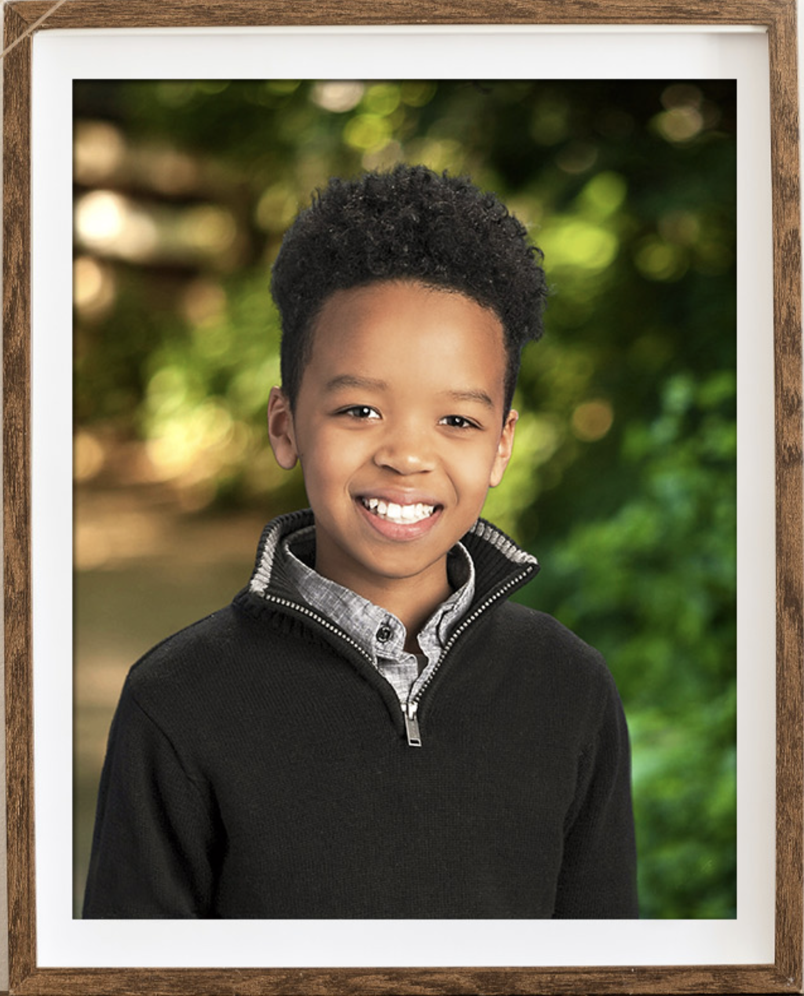


FALL Key events
https://www.laureloakpto.com/calendar
Last Day to Order Spirit Wear
September 30th
Fall Picture Day
September 30th
OCTOBER 26th
Fall Fundraiser Event & Art Show
Silent Auction Online (kick off Oct 19th)
Fall Picture Day
September 30th
Holiday House
December 6th – 10th
Book Fair
TBD

Slide 21
Spirit wear and spirit spy
Last Day to Order Spirit Wear
September 30th

Slide 22
Get involved
Read the newsletters
Sign up for the Email newsletters
Attend Fall Festival
Ask a teacher how you can help
Reach out to PTO with ideas / suggestions

